Slide 1

Example Presentation
Body Fat Project

Slide 2
Introduction
The goal of the project:
Coming up with a simple and accurate way of determinating body fat percentage of males based on readily available clinical measurements.

Slide 3
Summary of Data Cleaning
We impute individual BLANK’s due to BLANK
We deleted two individuals (BLANK and BLANK) due to BLANK
Final Cleaned Data: n=250 (from n=252) with p = 14 predictors
Predictors: every variable except ID number, body fat percentage, and density
Individual (IDNO) | Original Obs. | Imputed Obs. | Imputation Method
42 | HEIGHT=29.5 | HEIGHT=69.4 | ADIPOSITY=WEIGHT*703/HEIGHT^2
Individual (IDNO) | Original Obs.
182 | BODYFAT=0
172 | BODYFAT=1.9

Slide 4
Finding Best Model for Body Fat
Metric for Model Performance: We’ll define the “best” model based on the following criteria
AIC,BIC,cp
R^2,F-statistic,p-value
Candidate Models: Linear models with at most 15 predictors
BODYFAT ~ AGE + WEIGHT + NECK + ABDOMEN + HIP + THIGH + FOREARM + WRISTY
BODYFAT ~ WEIGHT + ABDOMEN + FOREARM + WRIST
BODYFAT ~ CHEST + ABDOMEN + HIP
BODYFAT ~ AGE + ADIPOSITY
BODYFAT ~ -29.7950 + 0.1610*pc1 + 0.1829*pc2
BODYFAT ~ -27.5858 + 0.1644*pc1 + 0.1759*pc2
We used greedy stepwise regression, Mallow's cp, principal component, and evaluated each candidate model’s performance

Slide 5
Results
Model | Rsquared | F-statistic | p-value
BODYFAT ~ AGE + WEIGHT + NECK + ABDOMEN + HIP + THIGH + FOREARM + WRIST | 0.7407 | 86.04 on 8 and 241 DF | < 2.2e-16
BODYFAT ~ WEIGHT + ABDOMEN + FOREARM + WRIST | 0.7303 | 165.9 on 4 and 245 DF | < 2.2e-16
BODYFAT ~ CHEST + ABDOMEN + HIP | 0.6923 | 184.5 on 3 and 246 DF | < 2.2e-16
BODYFAT ~ AGE + ADIPOSITY | 0.5613 | 158 on 2 and 247 DF | < 2.2e-16
BODYFAT ~ -29.7950 + 0.1610*pc1 + 0.1829*pc2 | 0.5178 | 132.1 on 2 and 246 DF | < 2.2e-16
BODYFAT ~ -27.5858 + 0.1644*pc1 + 0.1759*pc2 | 0.4973 | 121.7 on 2 and 246 DF | < 2.2e-16

Slide 6
Discussion of Results
You can go into more details about how you found your best model and/or the strengths/weakness of each model in words
Example 1: BLANK model is comparable to other BLANK models; the r-squared only increases by 3% at most.
Example 2: They are equally complex
You can also make some comments about the numerical or visual results above
Example 1: While model BLANK is better than model BLANK in terms of R^2, model BLANK has better than model BLANK in terms of BLANK.
Example 2: The predictor BLANK is significant across all models evaluated.

Slide 7
Final Model
BodyFat%= -29.7950 + 0.14WEIGHT + 0.04CHEST + 0.05ABDOMEN+ 0.03HIP +0.02THIGH + 0.17AGE
Some description of the final model in words
1: As men get older by one year, he is expected to gain 0.17% in body fat.
2: As men’s WEIGHT increases by one BL, he is expected to gain 0.14 % in body fat.
Some example usage of model
Example 1: Average American (CDC, 39inch waist): 23% with 95% PI (13.9%,31.6%)
Example 2: Usain Bolt (HealthCeleb, 33inch waist): 13.7% with 95% PI (5.1%,22.8%)
Example 3: By men’s pants size
Athletes | Fit | Average | Obese
6~14% | 14%~18% | 18% ~25% | 25%+
28 <= x < 30 | 30 <= x < 32 | 32<= x < 34 | 34 <= x < 36 | 36 <= x < 40
7.4% | 10.6% | 13.7% | 16.8% | 21.5%

Slide 8
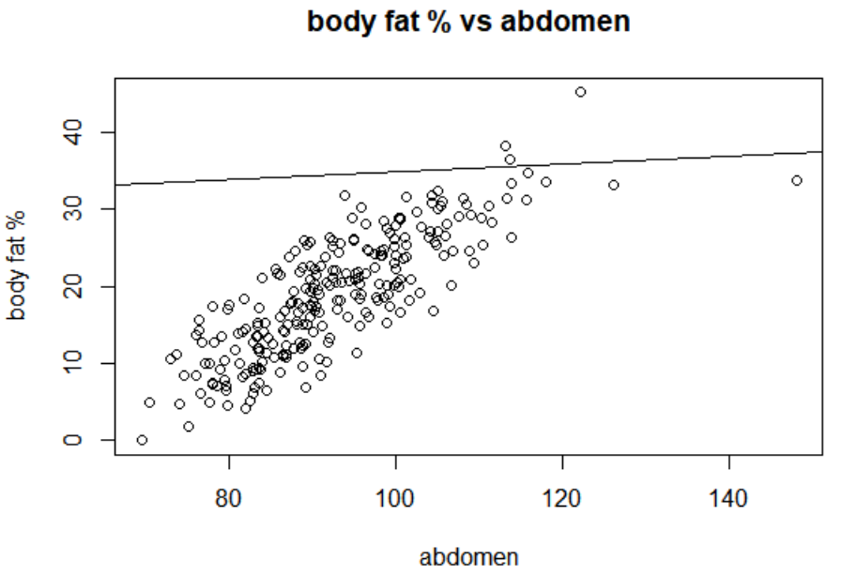
A Visual Description of Your Final Model

Slide 9
Statistical Properties of Final Model
Describe some important, statistical properties of the model
1: R^2=0.5178
2: F-statistic is 132.1 on 2 and 246 DF

Slide 10
Model Diagnostics
Discuss any model diagnostics you have done
Example 1: We used residual plot to diagnose linearity and homoskedasticity
Example 2: We checked for Normality of the error terms using BLANK
Example 3: We checked for influential/leverage points.
Present plots/tables/statistics in a concise and precise manner
What does this plot assess?
What should we be looking for?
Does your model meet the criterions? (e.g.plot looking flat, p-values,etc.)

Slide 11
Strengths and Weaknesses
Final Model:
BodyFat%= -29.7950 + 0.14WEIGHT + 0.04CHEST + 0.05ABDOMEN+ 0.03HIP +0.02THIGH + 0.17AGE
Strengths
This method could be wildly used for any other problem and be robust to multicollinearity.
It is easy to understand and get the result.
Weaknesses
If someone has some body statistics out of range, it may cause bad result.
The R-square is not close to 1, which means we need to improve the model.

